Slide 1
Bootcamp_Data Engineering Training
Prepared By,
Srimathi Chandrasekaran
21/05/2022

Slide 2
Chapter2: Python Spark in Depth
Intro to Spark in Bigdata -> 21/05/2022
Spark components & Architecture -> 21/05/2022
Pyspark shell , Pyspark job & Spark Web UI
Spark RDDs & DataFrames
Spark SQL & Spark Mllib
Spark GraphX

Slide 3
Intro to Spark in Bigdata
Spark applies Hadoop in two forms. The first form is storage and another one is processing. Thus, Spark includes its computation for cluster management and applies Hadoop for only storage purposes.
Apache Spark is a distributed and open-source processing system. It is used for the workloads of 'Big data'. Spark utilizes optimized query execution and in-memory caching for rapid queries across any size of data. It is simply a general and fast engine for much large-scale processing of data. Apache Spark is written in Scala programming language.
It is much faster as compared to the previous concepts to implement with Big Data such as classical MapReduce. Spark is faster die to it executes on RAM/memory and enables the processing faster as compared to the disk drivers.

Slide 4
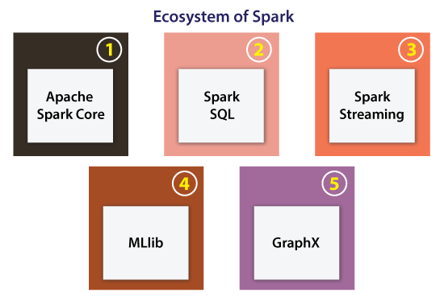
Apache Spark Evolution
Spark is one of the most important sub-projects of Hadoop. It was developed in APMLab of UC Berkeley in 2009 by Matei Zaharia. In 2010, it was an open-source under the BSD license. Spark was donated in 2013 to the Apache Software Foundation. Apache Spark is now a top-level project of Apache from 2014 February.
Ecosystem of Spark
The main components of
the Spark Ecosystem are explained:

Slide 5
Apache Spark Core: Apache Spark Core can be defined as an underlying normal execution engine for the platform of Spark. It facilitates referencing data sets and in-memory computing within the external storage structures.
Spark SQL: This component is a module of Apache Spark for operating with many kinds of structured data. Various interfaces provided by Spark SQL facilitates Spark along with a lot of information regarding both the computation and data being implemented.
Spark Streaming: Spark streaming permits Spark for processing streaming data in real-time. The data could be inhaling from several sources such as Hadoop Distributed File System (HDFS), Flume, and Kafta. After that data could be processed with complex algorithms and then pushed out towards the live dashboards, databases, and file systems.
Machine Learning Library (MLlib): Apache Spark is armed with a prosperous library called MLlib. The MLlib includes a wide range of machine learning algorithms collaborative filtering, clustering, regression, and classifications. Also, it contains other resources for tuning, evaluating, and constructing ML pipelines. Each of these functionalities supports Spark scale-out around the cluster.
GraphX: Apache Spark comes using a library for manipulating graph databases and implement computations known as GraphX. This component unifies Extract, Transform, and Load (ETL) process, constant graph computation, and exploratory analysis in an individual system.

Slide 6
Spark components & Architecture
The architecture of Spark contains three of the main elements which are listed below:
1.API
2.Data Storage
3.Resource Management
API
This element facilitates many developers of the applications for creating Spark-based applications with a classic API interface. Spark offers API for Python, Java, and Scala programming languages.

Slide 7
Data Storage
Spark applies the Hadoop Distributed File System for various purposes of data storage. It works with any data source that is compatible with Hadoop including Cassandra, HBase, HDFS, etc.
Resource Management
The Spark could be expanded as the stand-alone server. Also, it can be expanded on any shared computing framework such as YARN or Mesos.

Slide 8
PySpark:
To support Python with Spark, Apache Spark community released a tool, PySpark. Using PySpark, you can work with RDDs in Python programming language also. It is because of a library called Py4j that they are able to achieve this.
PySpark offers PySpark Shell which links the Python API to the spark core and initializes the Spark context. Majority of data scientists and analytics experts today use Python because of its rich library set. Integrating Python with Spark is a boon to them.

Slide 9
PySpark Setup:
Step 1 − Go to the official Apache Spark download page and download the latest version of Apache Spark available there.
In this tutorial, we are using spark-2.1.0-bin-hadoop2.7.
Step 2 − Now, extract the downloaded Spark tar file. By default, it will get downloaded in Downloads directory.
# tar -xvf Downloads/spark-2.1.0-bin-hadoop2.7.tgz
It will create a directory spark-2.1.0-bin-hadoop2.7.
Before starting PySpark, you need to set the following environments to set the Spark path and the Py4j path.
export SPARK_HOME = /home/hadoop/spark-2.1.0-bin-hadoop2.7
export PATH = $PATH:/home/hadoop/spark-2.1.0-bin-hadoop2.7/bin
export PYTHONPATH = $SPARK_HOME/python:$SPARK_HOME/python/lib/py4j-0.10.4-src.zip:$PYTHONPATH
export PATH = $SPARK_HOME/python:$PATH
Or, to set the above environments globally, put them in the .bashrc file.

Slide 10
Then run the following command for the environments to work.
# source .bashrc
Now that we have all the environments set,
let us go to Spark directory and invoke PySpark shell by running the following command −
# ./bin/pyspark
This will start your PySpark shell.
Welcome to
____ __
/ __/__ ___ _____/ /__
_\ \/ _ \/ _ `/ __/ '_/
/__ / .__/\_,_/_/ /_/\_\ version 2.1.0
/_/
Using Python version 2.7.12 (default, Nov 19 2016 06:48:10)
SparkSession available as 'spark'.
<<<

Slide 11
SparkContext:
SparkContext is the entry point to any spark functionality. When we run any Spark application, a driver program starts, which has the main function and your SparkContext gets initiated here. The driver program then runs the operations inside the executors on worker nodes.
SparkContext uses Py4J to launch a JVM and creates a JavaSparkContext. By default, PySpark has SparkContext available as ‘sc’, so creating a new SparkContext won't work.

Slide 12
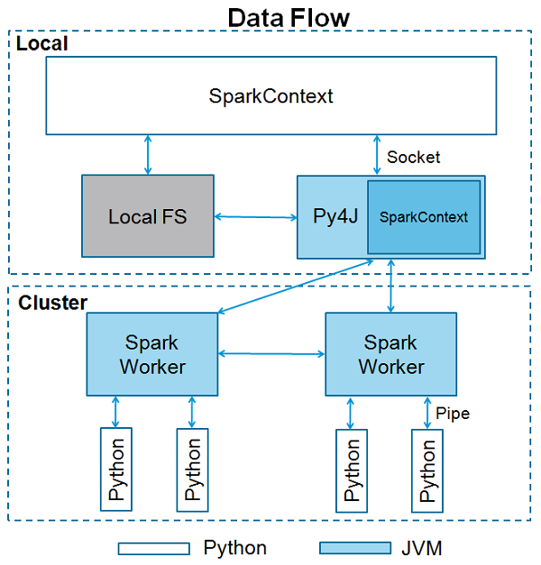

Slide 13
Parameters of a SparkContext
Master − It is the URL of the cluster it connects to.
appName − Name of your job.
sparkHome − Spark installation directory.
pyFiles − The .zip or .py files to send to the cluster and add to the PYTHONPATH.
Environment − Worker nodes environment variables.
batchSize − The number of Python objects represented as a single Java object. Set 1 to disable batching, 0 to automatically choose the batch size based on object sizes, or -1 to use an unlimited batch size.
Serializer − RDD serializer.
Conf − An object of L{SparkConf} to set all the Spark properties.
Gateway − Use an existing gateway and JVM, otherwise initializing a new JVM.
JSC − The JavaSparkContext instance.
profiler_cls − A class of custom Profiler used to do profiling (the default is pyspark.profiler.BasicProfiler).

Slide 14
SparkContext Example – PySpark Shell
Among the above parameters, master and appname are mostly used. The first two lines of any PySpark program looks as shown below −
from pyspark import SparkContext
sc = SparkContext("local", "First App")
Now that you know enough about SparkContext, let us run a simple example on PySpark shell. In this example, we will be counting the number of lines with character 'a' or 'b' in the README.md file. So, let us say if there are 5 lines in a file and 3 lines have the character 'a', then the output will be → Line with a: 3. Same will be done for character ‘b’.

Slide 15
Note − We are not creating any SparkContext object in the following example because by default, Spark automatically creates the SparkContext object named sc, when PySpark shell starts. In case you try to create another SparkContext object, you will get the following error – "ValueError: Cannot run multiple SparkContexts at once".
<<< logFile = file:///home/hadoop/spark-2.1.0-bin-hadoop2.7/README.md
<<< logData = sc.textFile(logFile).cache()
<<< numAs = logData.filter(lambda s: 'a' in s).count()
<<< numBs = logData.filter(lambda s: 'b' in s).count()
<<< print "Lines with a: %i, lines with b: %i" % (numAs, numBs) Lines with a: 62, lines with b: 30

Slide 16
SparkContext Example - Python Program
Let us run the same example using a Python program.
Create a Python file called firstapp.py and enter the following code in that file.
from pyspark import SparkContext
logFile = "file:///home/hadoop/spark-2.1.0-bin-hadoop2.7/README.md"
sc = SparkContext("local", "first app")
logData = sc.textFile(logFile).cache()
numAs = logData.filter(lambda s: 'a' in s).count()
numBs = logData.filter(lambda s: 'b' in s).count()
print "Lines with a: %i, lines with b: %i" % (numAs, numBs)
Then we will execute the following command in the terminal to run this Python file. We will get the same output as above.
$SPARK_HOME/bin/spark-submit firstapp.py
Output: Lines with a: 62, lines with b: 30

Slide 17



